Slide 1
ISM 6136
Data Mining
Dr. Tim Smith

Slide 2
Agenda
08:35-09:00 – Recap of Class03, Quiz3
09:00-09:35 – Review and Expand on Ideas Covered
Break
09:50-11:00 – Decision Trees

Slide 3
Recap of Class03, Quiz3

Slide 4
Review and Expand on Ideas Covered

Slide 5
Data Partitioning
Data Set: This is the entire set of observations you have for your analysis. This data is split (ideally) into three subsets:
Training Data:
This is a portion of the Data Set that is randomly selected and marked for training. This data is used to tune the parameters of the various models you wish to test.
Validation Data: This is a portion of the Data Set that is used to see how well the candidate models perform on ‘unseen’ data.
Test Data: After the final model is selected, the Test Data is used to develop an unbiased score of the selected models performance.

Slide 6
Data Partitioning
Determine set of models that you will use
Train these models on the training set
Compare how well these models perform on the validation set
With information on the performance of these models, either go back to Step 1 or select the ‘best model’ and proceed to Step 5.
Measure the performance of the final selected model on the test set.
Training Data
Entire Data Set
Validation Data
Test Data
In practice, we find a two partition approach: The training set, and the remaining set that is used for both validation and test.

Slide 7
Data Split Ratio
I know many of you would like me to provide concrete rules around data split percentages and sample sizes. As I’ve indicated in class, it’s not an easy question to answer.
Today, I will elaborate more the considerations involved.
Two considerations:
Model complexity (# of parameters)
The number of observations (N) you have

Slide 8
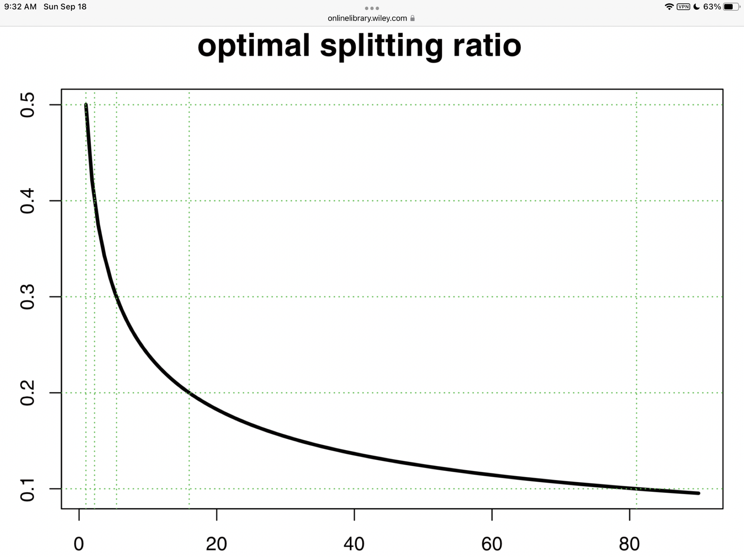
Model Complexity
There are a number of papers that have explored the optimum data split.
Though the conclusions vary, a common these is: As the complexity of the model being fit increases, the percentage allocated to the training set should increase.
But often, we may test a number of models, and we may have different complexities, and/or may not know the actual number of parameters.
This somewhat ambiguous situation has let to practitioners using a ‘general rule of thumb. In such cases, a general range is used…
“a 1/4 or 1/3 ratio used by practitioners is reasonable when the number of parameters is unknown” (Joseph, 2022)
Percentage for Testing
Number of Parameters
Joseph, V. R. (2022). Optimal ratio for data splitting. Statistical Analysis and Data Mining: The ASA Data Science Journal.

Slide 9
Sample Size
In traditional statistics, there are methods to indicate the power of a model based on the number of observations used. In machine learning (and data mining), we use a data driven approach. But, how much data do we need?
In general, the more the better (if we can handle the processing of it).
One paper (Beleites, et al, 2012) offers the general rule of thumb that for classification models, it should be greater than 100. This is very context sensitive though, and a difficult value to generalize.
Be weary of applying machine learning (data driven) techniques on small sets of data.
In general, if you have a somewhat complex model with many observations – use the 60/40 or 70/30 rule.
Favor the 70/30 with what you feel is a smaller large set.
Beleites, C., Neugebauer, U., Bocklitz, T., Krafft, C., & Popp, J. (2013). Sample size planning for classification models. Analytica chimica acta, 760, 25-33.

Slide 10
Levels of Measures in Data
Nominal
Ordinal
Interval
Ratio

Slide 11
Nominal Data
Categorizing your data by labelling them in mutually exclusive groups, but with no order between the categories.
Examples:
City of birth
Gender
Ethnicity
Car brands
Marital status

Slide 12
Ordinal Data
Categorize and rank your data in an order, but you cannot say anything about the intervals between the rankings.
Examples:
Top 5 Olympic medalists
Language ability (e.g., beginner, intermediate, fluent)
Likert-type questions (e.g., very dissatisfied to very satisfied)

Slide 13
Interval Data
Categorize, rank, and infer equal intervals between neighboring data points, but there is no true zero point.
Examples:
Test scores (e.g., IQ or exams)
Personality inventories
Temperature in Fahrenheit of Celcius

Slide 14
Ratio Data
You can categorize, rank, and infer equal intervals between neighboring data points, and there is a true zero point.
Examples:
Height
Age
Weight
Temperature in Kelvin

Slide 15
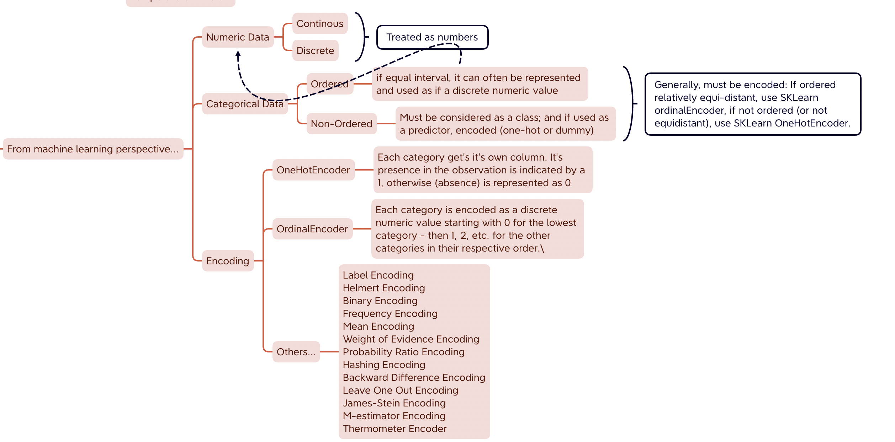
From machine learning perspective…

Slide 16
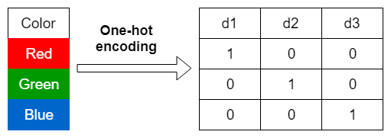
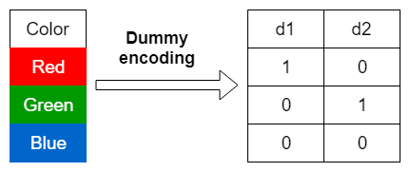
Difference Between One-Hot and Dummy Encoding
Using Pandas…
pd.get_dummies(data, prefix, dummy_na, columns, drop_first=False)
Using sklearn…
ohe = OneHotEncoder(categories, drop=None, sparse)
Using Pandas…
pd.get_dummies(data, prefix, dummy_na, columns, drop_first=True)
Using sklearn…
ohe = OneHotEncoder(categories, drop=‘first’, sparse)

Slide 17
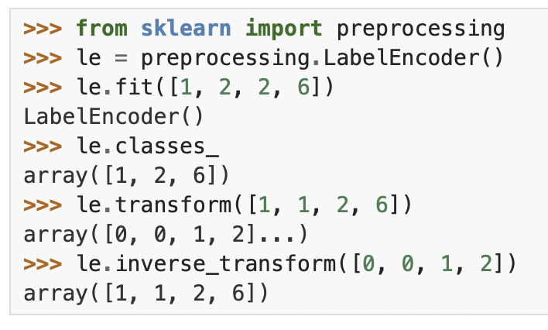
What about ordered categories?
Use LabelEncoder or OrdinalEncoder from sklearn.
LabelEncoder is used to encode target variables
OrdinalEncoder is used to encode input variables
In general, don’t use OrdinalEncoder unless you’re confident (this will be an underlying assumption) that the categories are equidistant apart.
See https://scikit-learn.org/stable/modules/generated/sklearn.preprocessing.LabelEncoder.html

Slide 18
Addressing Data Imbalance
There are two general approaches to handling unbalanced data:
1. Data-level methods: modify the training distribution to decrease the level of imbalance.
Under-sampling
Over-sampling
Data augmentation by generating synthetic data based on existing data patterns
2. Algorithm-level methods: adjust the learning process to increase the importance of the smaller classes during training time.
Adjusting class weights

Slide 19
Imbalance Data
Resampling (this is part of the assignment 02, so I will not demonstrate a solution until after Thursday).
Changing class weights/Altering the ‘cut-off’ of the machine learning algorithm.
See c05-imbalance.ipynb for demonstration of the second approach

Slide 20
Decision Trees and Pruning

Slide 21
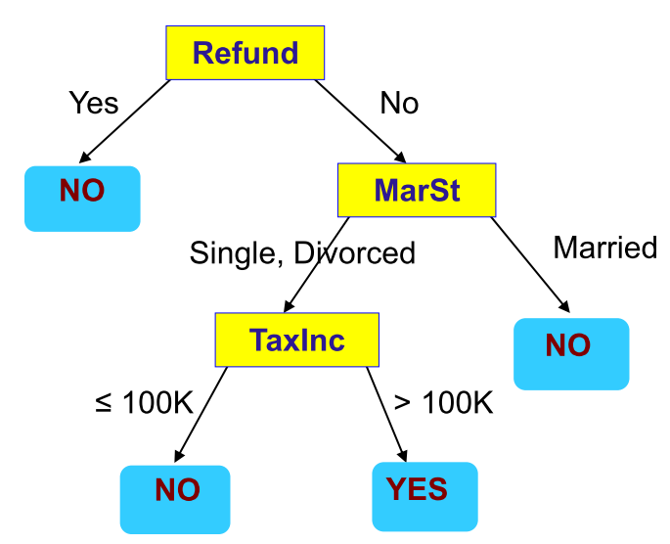
Decision Tree
Supervised Learning Model
Predictors/features/attributes as input
Predicted Output/Outcome can be checked with known result
Flowchart like Tree structure
Two types of Decision Tree:
Classification Tree (outcome is classification) ← this is our focus in this course
Regression Tree (outcome is continuous)
Root Node
Internal Nodes
Leaf Nodes

Slide 22
Decision Tree
Consists of…
Nodes and Branches
Outcomes and Predictors
Predictors
Outcomes

Slide 23
Decision Tree
Root Node
Internal Nodes
Leaf Nodes

Slide 24
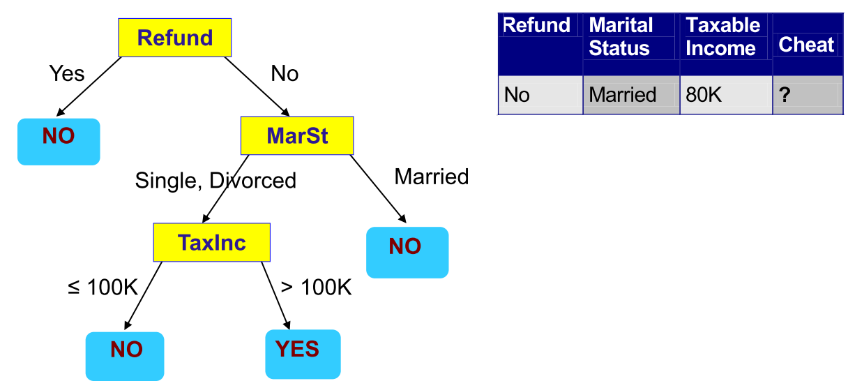
How are decision trees used for classiﬁcation?
whether a tax filer has cheated in his/her taxes

Slide 25
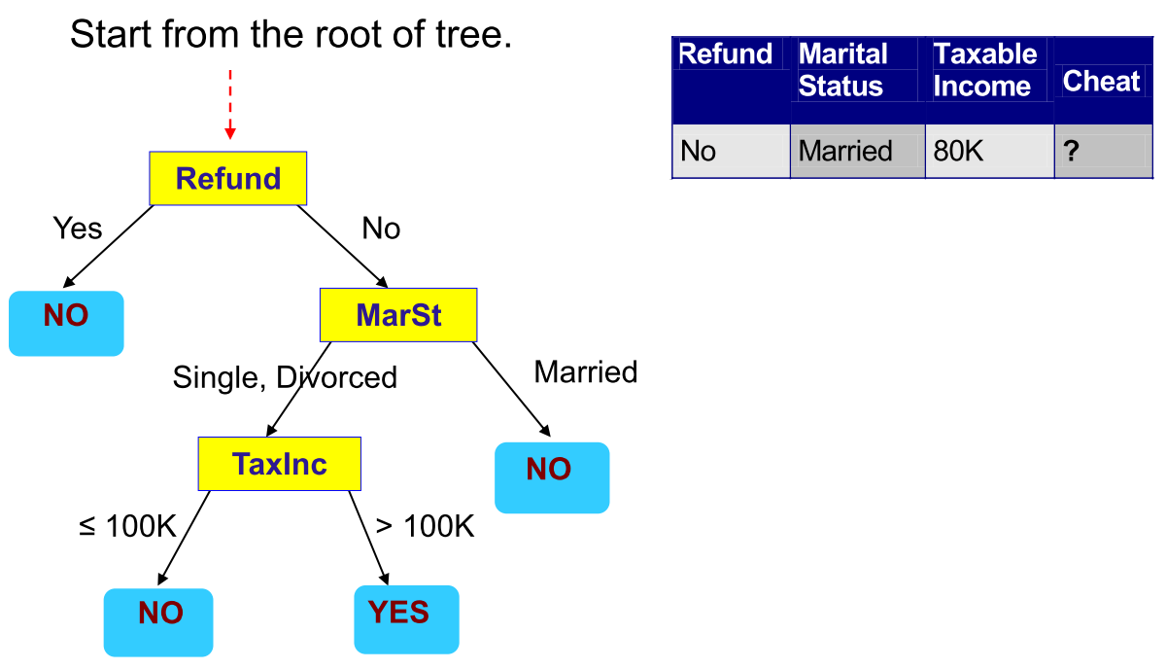
How to Use the Decision Tree?

Slide 26
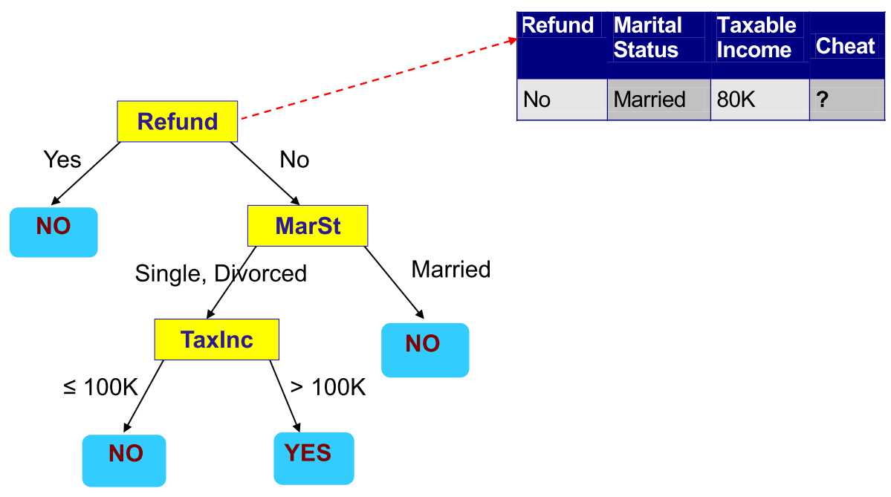
How to Use the Decision Tree?

Slide 27
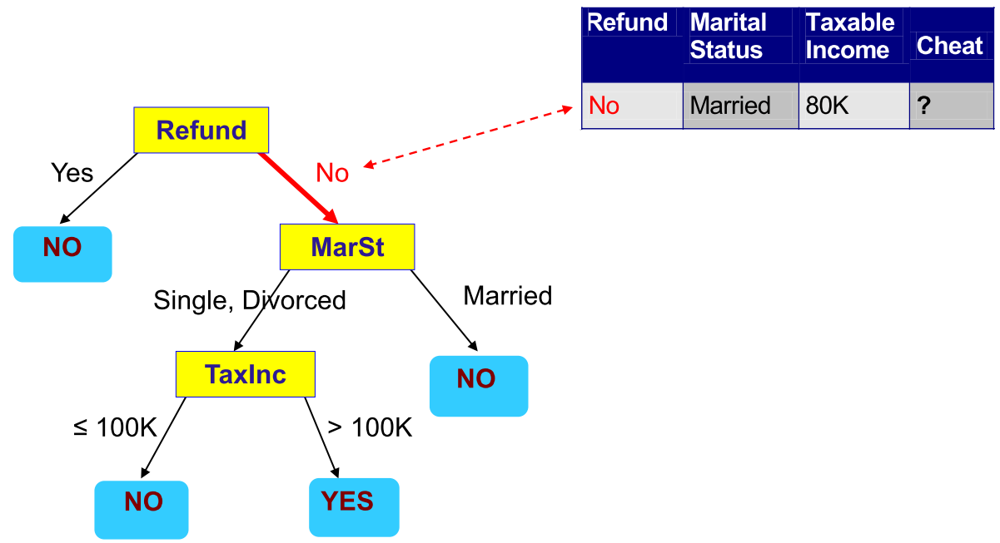
How to Use the Decision Tree?

Slide 28
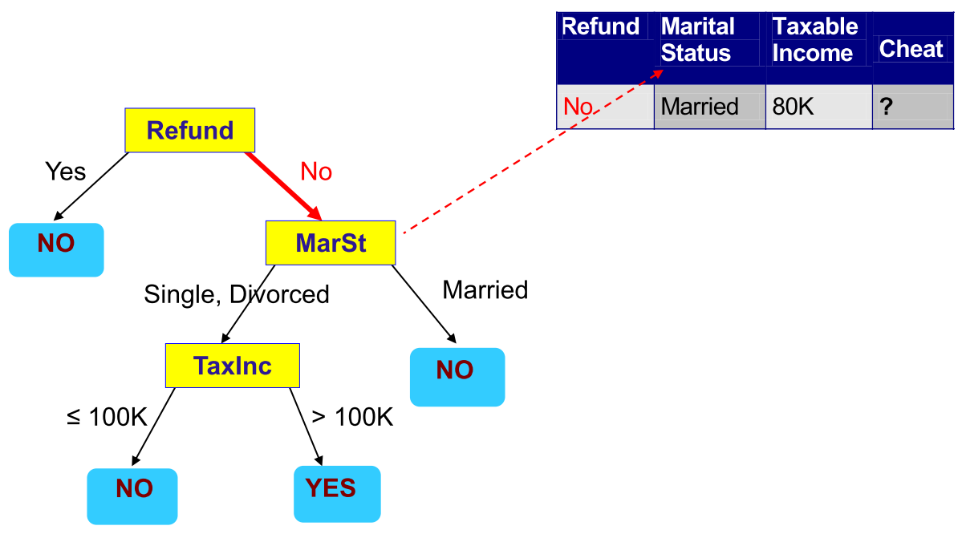
How to Use the Decision Tree?

Slide 29
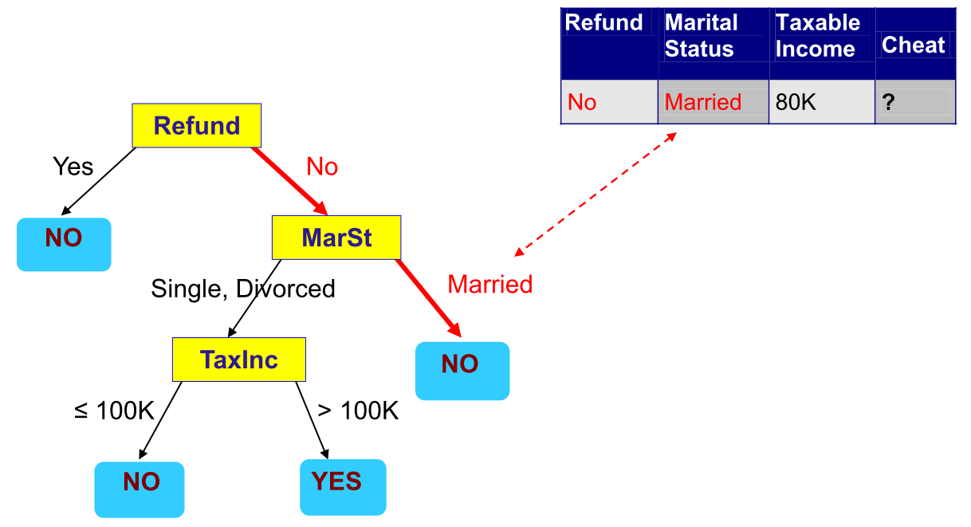
How to Use the Decision Tree?

Slide 30
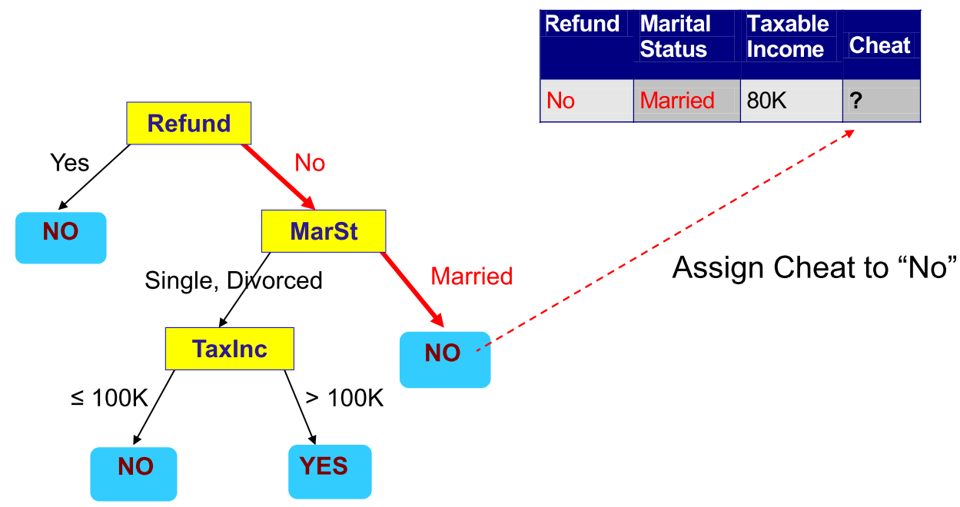
How to Use the Decision Tree?

Slide 31
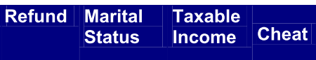
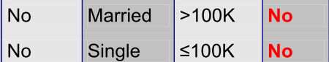
Question
?

Slide 32
Answer

Slide 33
How to create/build decision tree
Top-down recursive partitioning
Select feature for first (root) node
Split given node into branches
Continue until no features left to use a node OR we have perfect fit

Slide 34
Building tree
How do we split a feature?
For Categorical predictor
binary – split to two branch
multiple classes – split to number of distinct classes
For continuous predictor
Binary split – optimal value
Multiple way split - binning

Slide 35
Building tree
Which order of features to split with?
Different orders of splitting will create different trees.
We’re finding the best fitting tree, so we test which node split will be better than the others.

Slide 36
Information gain as means of selecting nodes
Input Data
Input Data
More information gained
Refund Received is a “better rule
Refund Received
✓
Marital Status
Rule
Rule
Information Gain
Yes
No
Yes
No

Slide 37
How we quantify information gain?
Measure Entropy:
Higher entropy means more disorder
Lower entropy means less disorder
Measure Purity/Homogeneity
Higher purity/homogeneity means more order
Lower purity/homogeneity means less order
More disorder = more information
Less disorder = less information
If we move from more disorder to less disorder – we have extracted information

Slide 38
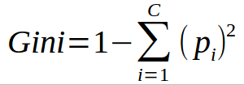
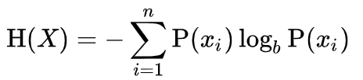
Two common measures
Gini Index – measure of homogeneity (sameness)
Entropy – another measure the accomplishes the same task
i = feature
c = # of features
i = feature
n = # of features
b = 2 (bits) or e (nats) or 10 (bans)
… use base 2
https://web.archive.org/web/19980715013250/http://cm.bell-labs.com/cm/ms/what/shannonday/shannon1948.pdf

Slide 39
Using Gini Index
Input Data
1-(3/8)²-(5/8)²= 0.46875
Refund Received
Rule
Information gain = 0.46875-0.27778 = 0.19097
Yes
No
(2/8)*0+(6/8)*0.27778=0.27778
1-(2/2)²-(0/2)²= 0
1-(1/6)²-(5/6)²= 0.27778

Slide 40
Using Gini Index
Input Data
1-(3/8)²-(5/8)²= 0.46875
Refund Received
Rule
Information gain = 0.46875-0 = 0.46875
Yes
No
(3/8)*0+(5/8)*0=0
1-(3/3)²-(0/3)²= 0
1-(0/5)²-(5/5)²= 0

Slide 41
Select node with greatest gain
Input Data
Input Data
Homogeneity Gain
Homogeneity Gain
0.19097
0.46875
Marital Status
Rule
Refund Received
Rule
Yes
No
Yes
No
Notes:
0.19097

Slide 42
Two common measures
Gini Index – measure of homogeneity (sameness)
Entropy – another measure the accomplishes the same task
i = feature
c = # of features
i = feature
n = # of features
b = number of branches

Slide 43
Using Entropy Loss
Input Data
-(3/8)log₂(3/8) - (5/8) log₂(5/8) = 0.954434
Refund Received
Rule
Information gain = 0.954434-0.650022 = 0.304412
Yes
No
(2/8)*0+(6/8)*0.650022=0.650022
=-(2/2)*log2(2/2) = 0
-(1/6)log₂(1/6)-(5/6)log₂(5/6) =0.650022

Slide 44
Using Entropy Loss
Input Data
-(3/8)log₂(3/8) - (5/8) log₂(5/8) = 0.954434
Refund Received
Rule
Information gain = 0.954434-0.0 = 0.954434
Yes
No
(2/8)*0+(6/8)*0.0=0
-(3/3)*log2(3/3) = 0
-(5/5)log₂(5/5) =0

Slide 45
Select node with greatest Entropy loss
Input Data
Input Data
Entropy loss
Entropy loss
0.304412
0.9554434
Marital Status
Rule
Refund Received
Rule
Yes
No
Yes
No
Notes:
0.19097

Slide 46
“Recursive” Keep going until we either get a perfect fit, or we run out of features
Input Data
Feature 1 Rule
Rule
Yes
No
Feature 2 Rule
Yes
No

Slide 47
Why use Decision Tree?
Pro
Handles multiple features
Handles multiple classifications (beyond binary)
Simple, easy to interpret the model
Acceptable/good performance
Cons
Tends to “overfit”
Solution: “pruning”
Use other methods: Random Forest, Boosted Trees (next week)
Greedy algorithm – chooses best fit without looking ahead (for instance choosing a suboptimal split could yield better results in later splits)
Can be unstable – small variations in predictive values can result in very different trees.
We will explore solutions to this next week

Slide 48
Guarding against Overfitting: Pruning
Limit Leaves
Limit the number of leaf nodes
Limit depth
Limit the depth of the tree
Limit splits
Limit the number of splits (splits=rules when binary)
Limit threshold
do not add a rule unless it meets a minimum gain threshold

Slide 49
Let’s see this in action
C05-dtree.ipynb

Slide 50
Deliverables this week…

Slide 51
Due this week
Discussion forum posting (and reply)
Assignment 03
Work on your assigned team
Each team will submit one assignment
Optional: BONUS04
Data Camp Course Streamlined Data Ingestion with Pandas

Slide 52
Happy Learning!

